Slide 1





The Development of
VISPA @ WEB
by
Matthias Komm
RWTH Aachen, 10.8.2010
Betreuer:
Prof. Dr. Martin Erdmann, Dipl.-Phys. Gero Müller
III. Physikalisches Institut A

Slide 2
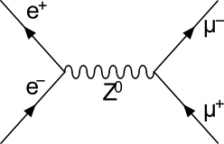
Physics analysis
HEP example: Measurement of Z⁰ mass
- working efficiently with a huge amount of data
Analysis is programmed (favored language: C++)
in C++ written analyses:
unclear, difficult to read
no fast prototyping
Physicists lose focus, have to learn a complex language
analysis code must be maintained

Slide 3
Alternative:
Graphical Development Environment:
intuitive
simple development
fast modifiable/exchangeable
analysis logic is visualized
VISPA
+ web based:
no installation, no administrator rights needed
independent of the client's computer resources
working together over the web

Slide 4
Technology: „AJAX“
Server:
Python
PXL (Physics eXtension Library)
Communication:
HTTP
JSON
Client:
Web Browser
Java-Script
AJAX = Asynchronous JavaScript and XML

Slide 5
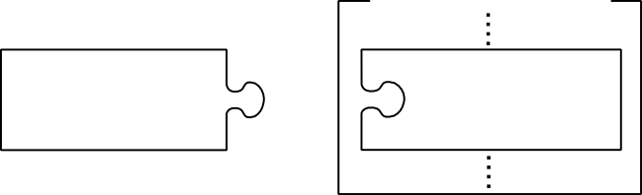
Web Server
Requirement:
assigning of physics analyses to clients
          Identification over analysis session ID
Client
Server
list of analyses
Request:
session ID
command
Analysis:
session ID
pxl::Analysis

Slide 6
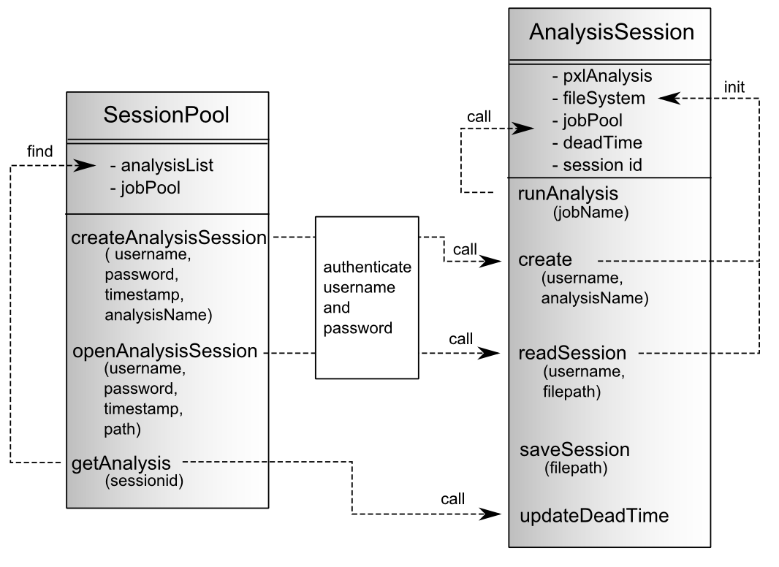
Management

Slide 7
The virtual file system
Clients are allowed to create/ modify files on server:
- Security: clients should not work directly with the
server's file system
Use a virtual file system: Translate the file paths
GetFullFilePath
virtual file system
eg. 'user/test.py'
real file system
eg. 'C:/work/test.py'
GetStrippedFilePath
filter file extensions
new: '/user', '/global' (read-only), import files

Slide 8
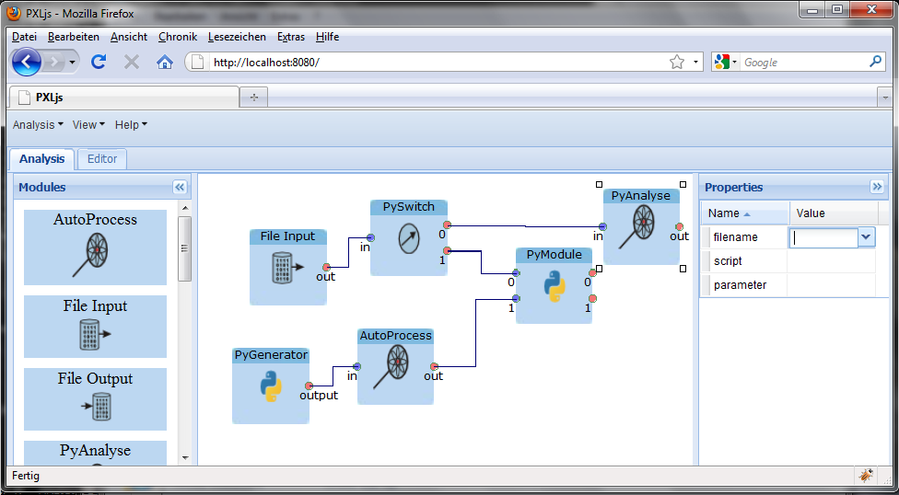
Graphical User Interface
Menu
Tabs
available modules
workflow
module's options

Slide 9
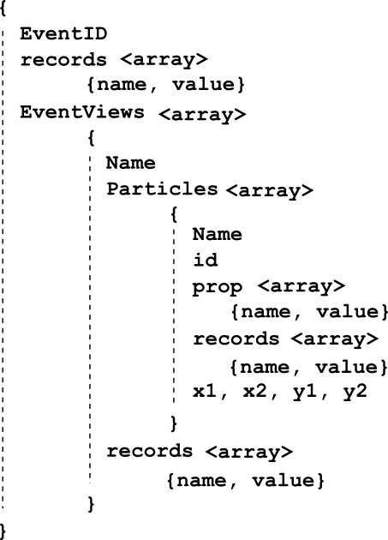
Accessing 'pxlio' files
For displaying an event:
Access information
  - properties
  - user records
  - layout positions
Write into special data format
Sent amount of data is controllable

Slide 10
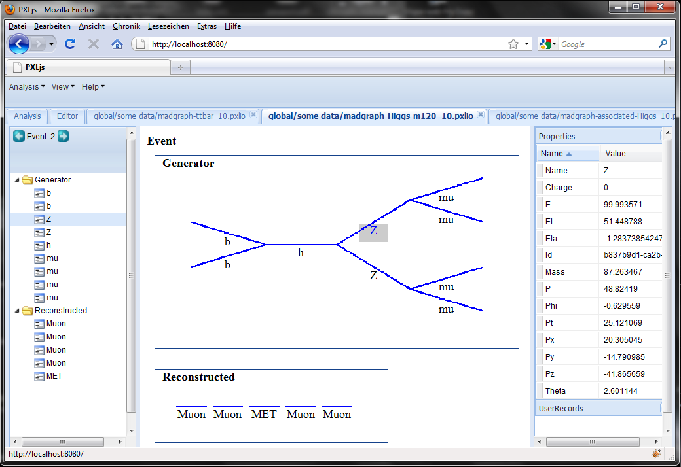
Data browser
Current
Event
Decay tree
Event
Overview
Event views
Particle
properties

Slide 11
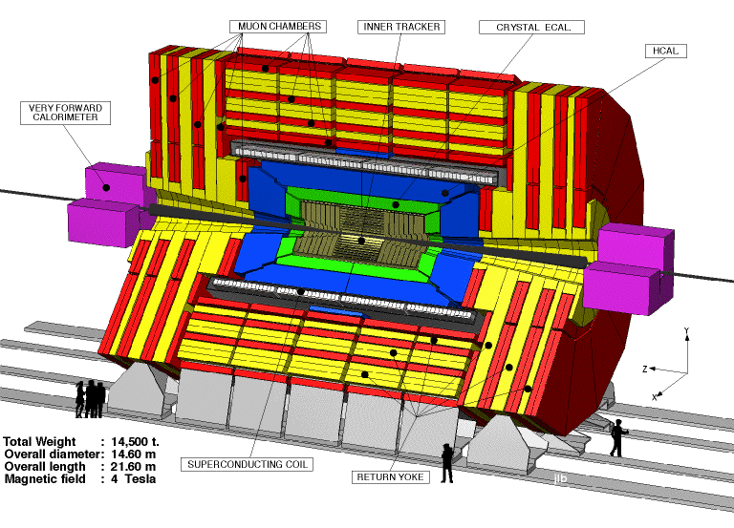
A Demonstration:
Dijet mass measurement with CMS data:
LHC (Large Hadron Collider), pp-collider at CERN
CMS (Compact Muon Solenoid), general purpose detector at LHC

Slide 12
Jets:
Strong interaction of final state quarks
→ hadronic showers → jets
Dijet mass → quantity for the center-of-mass energy of
an interacting two quark system
Data: recorded at in April 2010, ~2200000 events
with minimum bias trigger
Monte-Carlo: QCD Pythia with full detector simulation,
200000 events
Applied Cuts:
Leading and sub-leading jet:
-
-
-
-
872 data events,
158440 MC events selected

Slide 13
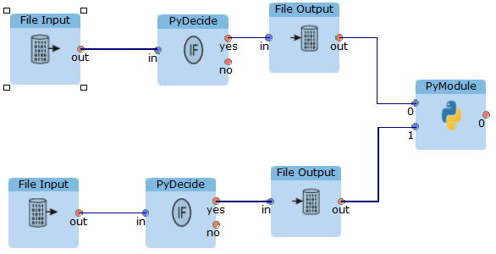
The Analysis:
Save selected
events
data
Cuts
MC
Compare
data & MC

Slide 14
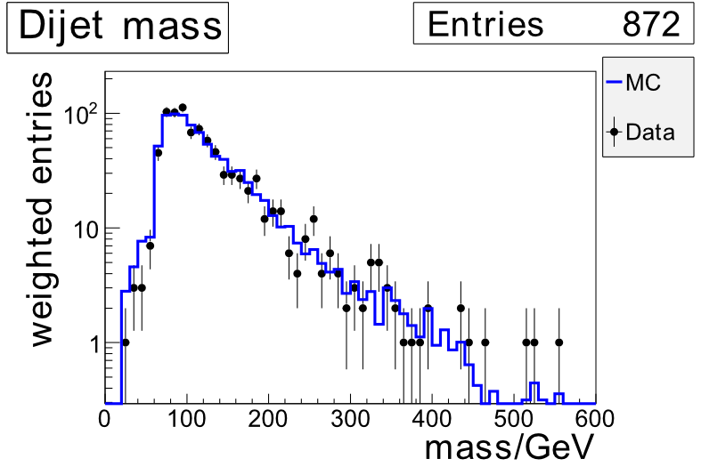
Result:
The data is well describable by the Monte-Carlo within its uncertainties

Slide 15
Conclusion:
Implementation of VISPA @ WEB:
  - used various libraries like PXL, JSON, …
  - developed concepts like analysis session mangement
  - demonstrate its capabilities with a dijet analysis
New possibilities:
a new way to perform physics analyses
improves clarity by its graphical overlay
redirects the focus back to the physics
through PXL: analyses with any degree of complexity
Physicists can work together over the web
Prototyping, performing and verifying of physics analyses with a standard web browser

Slide 16
Further information:
→ Bachelor thesis: Matthias Komm, Development of the VISPA @ WEB program and Measurement of the dijet mass with CMS, 2010
Thank you for your attention!
Questions?

